Slide 1
WEB TECHNOLOGIES
MoVieReview– Movie review sharing system

Slide 2
TEAM MEMBERS
NIXIT AHIR 8748790
TUSHAR PATEL 8717066
JIGNESH KUMAVAT 8769704
NEMI DESAI 8769751

Slide 3
ROADMAP
INTRODUCTION
TEAM-WORK
FEATURES
TECHNOLOGIES USED

Slide 4
INTRODUCTION
EASILY AVAILABLE Review FOR USERS
DESIGNED UPON UX/UI
EFFORTLESS
USER FRIENDLY WEBSITE

Slide 5
ROADMAP
INTRODUCTION
TEAM-WORK
FEATURES
TECHNOLOGIES USED

Slide 6
TEAM-WORK
UNIQUE IDEAS
STRATEGY AND PLANNING
PROJECT MANAGEMENT
DESIGNING
APPROPRIATE FEEDBACK
SITE PRODUCTION

Slide 7
ROADMAP
INTRODUCTION
TEAM-WORK
FEATURES
TECHNOLOGIES USED

Slide 8
FEATURES
MOVIES REVIEW SYSTEM
USER CAN SHARE THEIR REVIEW
MOVIES DETAILS IN SIMPLE UI VIEW
EASILY INTEGRATED WITH .NET API SYSTEM

Slide 9
ROADMAP
INTRODUCTION
TEAM-WORK
FEATURES
TECHNOLOGIES USED

Slide 10
TECHNOLOGIES USED
VUE JS
HTML5
CSS3
JAVASCRIPT
GOOGLE CHROME
VISUAL STUDIO CODE
ENTITY FRAMEWORK
.NET
VISUAL STUDIO COMMUNITY
SWAGGER UI
AXIOS

Slide 11
STEPS
DEVELPED FRONT END WITH VUE JS
DEVELOPED BACKEND WITH .NET FRAMWORK
DATABASE INETEGRATION WITH SWAGGER UI AND MICROSOFT ENTITY FRAMEWORK

Slide 12
SCHEMA
COMMENT
PRODUCT
WEATHER FORECAST (DEFALUT)

Slide 13
CONTROLLERS
PRODUCT(MOVIE) CONTROLLER
COMMENTS CONTROLLER

Slide 14
DATA ENTRIES
GET METHOD
POST METHOD
JSON FORMATE DATA FOR HANDLING

Slide 15
COMMANDS
Add-migration initizeData
Update-database

Slide 16
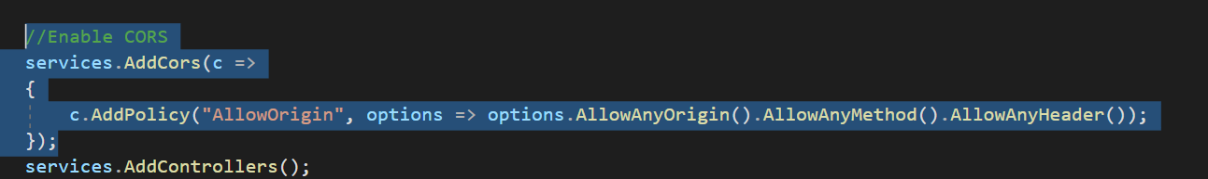
ALLOW ACCESS API

Slide 17
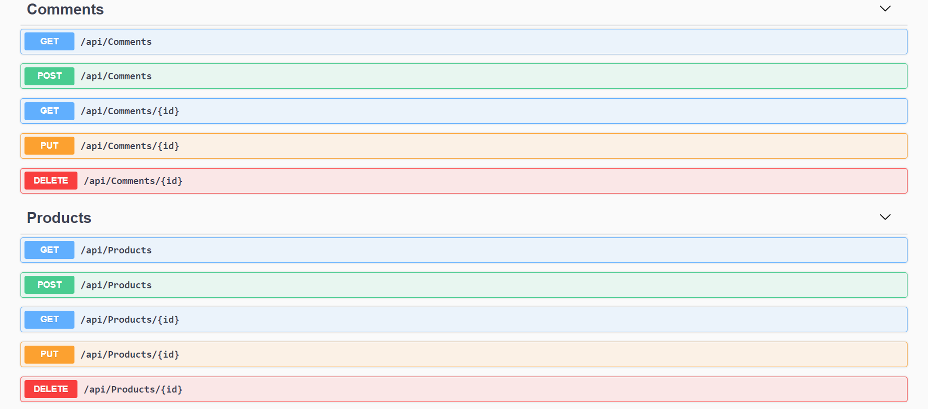
CONTROLLER

Slide 18
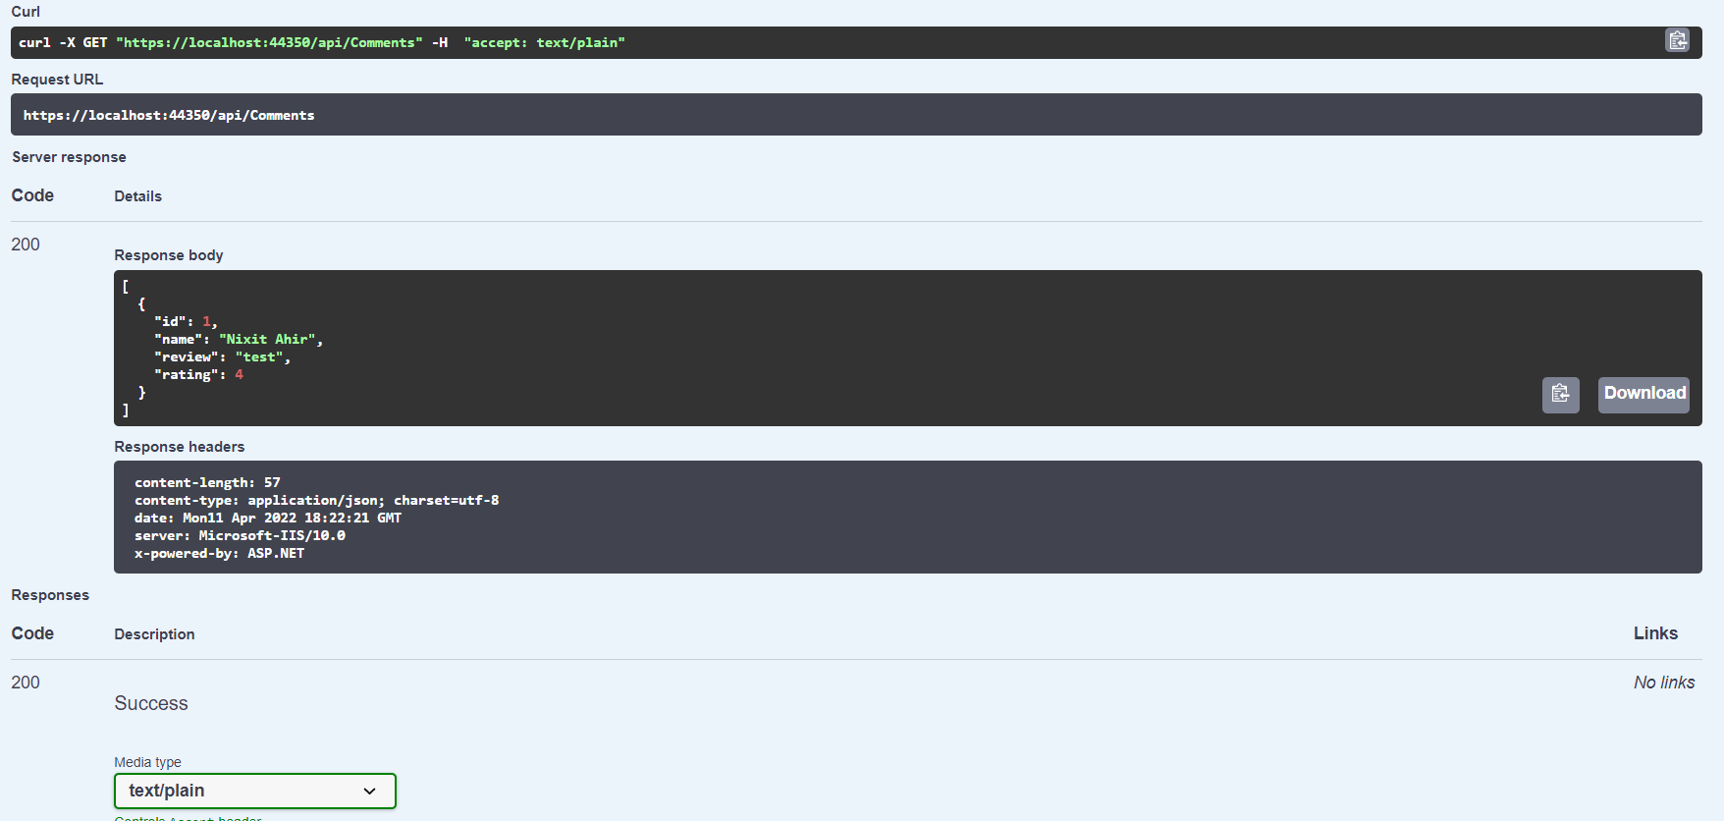
GET REQUEST

Slide 19
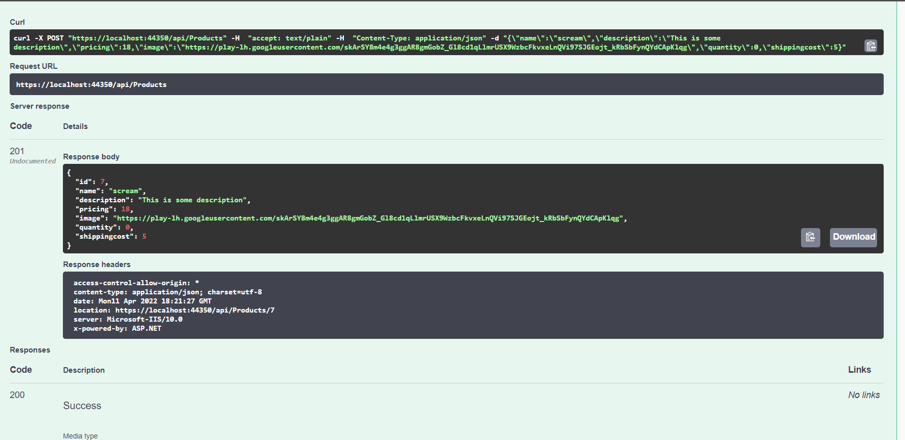
POST REQUEST

Slide 20
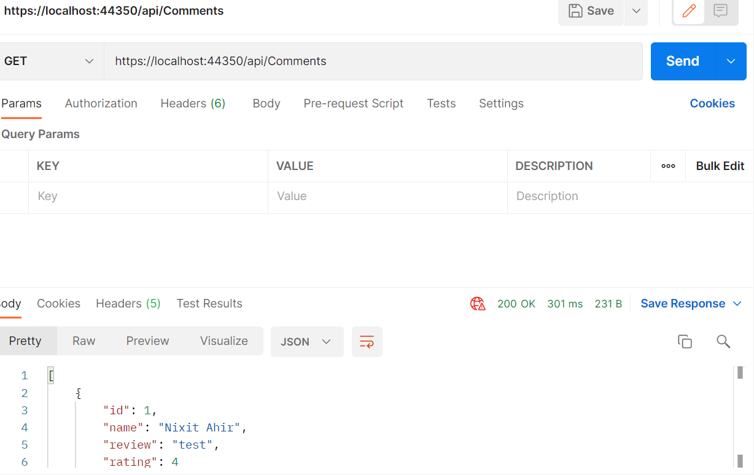
POSTMAN

Slide 21
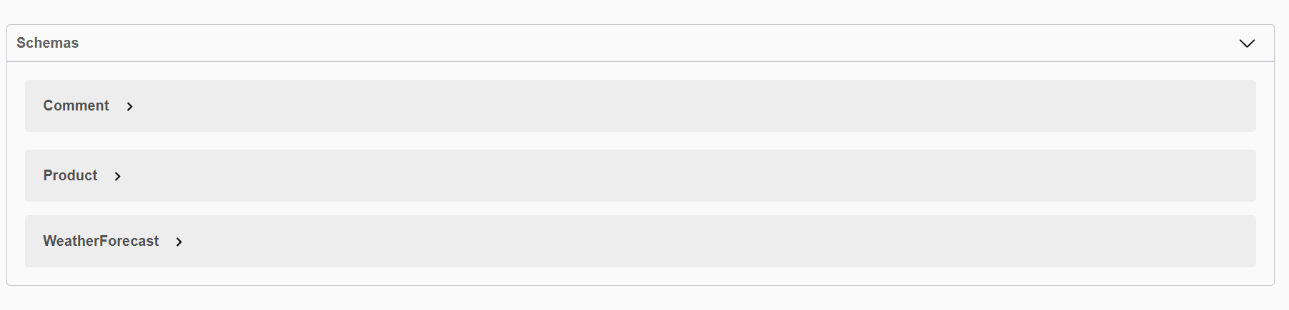
SCHEMA

Slide 22

Thank You

